Slide 1
Subsurface Geology & Well logging
Assistant Professor Dr. Muwafaq Fadhil Al-Shahwan
Department of Geology, College of Science, Basrah University

Slide 2
Lecture 1: An Introduction
Essential Definitions of subsurface Geology & Well Logging.
Well logs -definition.
Well log – classification.
borehole environment
Invasion.
Drilling mud.
some property of formation surrounding the well which affect logging measurement

Slide 3
Well Logs … The most appropriate name is wireline geophysical well log.
conveniently shortened to well – log or log. It has often been called Electric Log because the first logs were electrical measurement, in France, which invented by Conrad Schlumberger and Henri Doll (1912-1920).

Slide 4
To run logs, the hole is cleaned and stabilized, and the drilling equipment extracted
The log lowered into the maximum drilled depth and logs are run while pulling up with constant speed between 300m/h and 1800m/h, depending to the tool used.

Slide 5
Wireline Logging Definition
Well Log: Continuous record of
properties of rock, and other
subsurface measurements:
(Resistivity, Density, Dipping, Pressure, Porosity, Imaging,…etc) against depth.

Slide 6
HISTORY
1912 Conrad Schlumberger give the idea of using electrical measurements to map subsurface rock bodies.
in 1919 Conrad Schlumberger and his brother Marcel begin work on well logs.
The first electrical resistivity well log was taken in France, in 1927.
The instrument which was use for this purpose is called SONDE, the sond was stopped at periodic intervals in bore hole and the resistivity was plotted on graph paper.
In 1929 the electrical resistivity logs are introduce on commercial scale in Venezuela, USA and Russia
For correlation and identification of Hydrocarbon bearing strata.
The photographic – film recorder was developed in 1936 the curves were SN and LN
The dip meter log were developed in 1930
The Gamma Ray and Neutron Log were begin in 1941

Slide 7
Objectives:
1. Identify the principal petrophysical log data types (natural gamma-ray; sonic; deep, shallow and micro-resistivity; neutron and density measurements) and explain their acquisition and measurement techniques, and purpose.
2. Define the reference information on a log print header and explain how each parameter is measured, and why it is recorded.
3. Describe process and key steps to correctly validate log data for entry into master database or for further processing. Explain the key QC steps necessary.
4. Identify the reservoir from a simple set of logs and demonstrate ability to calculate approximate water saturation in a clean formation

Slide 8
Basic Rock Properties
There are four fundamental properties used in the description and analysis of Hydrocarbon bearing rocks.
– Porosity
– Saturations (water Sw, Oil So, Gas Sg)
– Permeability
–Resistivity

Slide 9
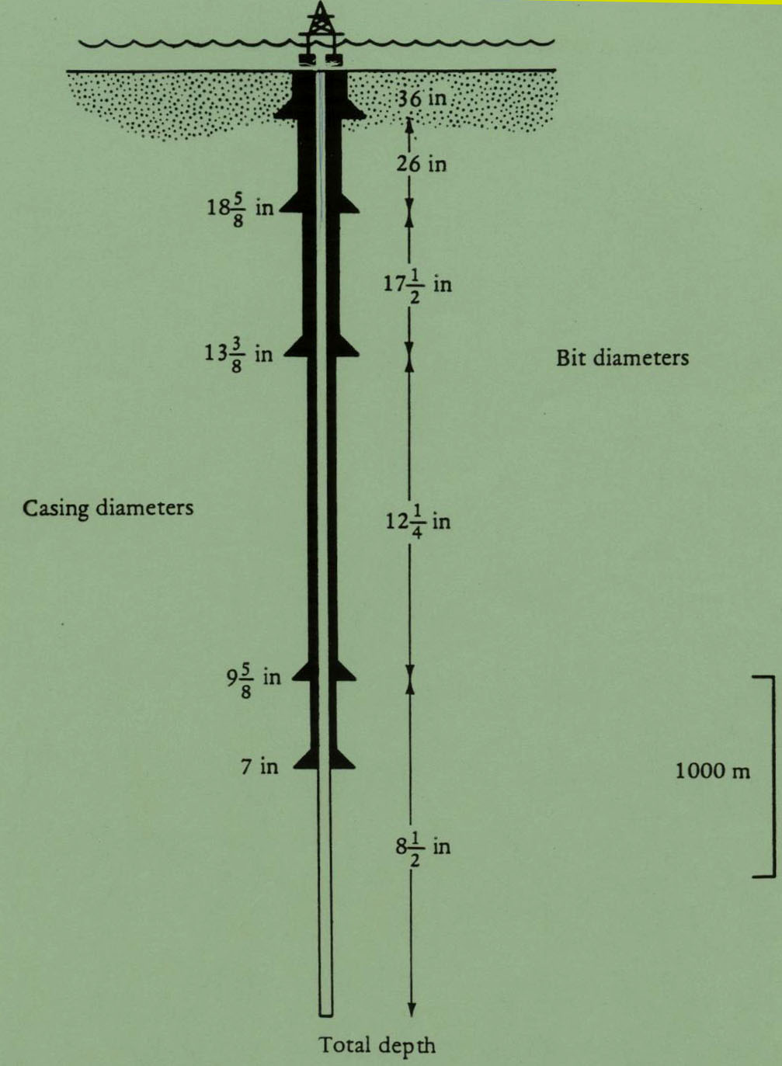
Drilling and Completion
Casing is set to prevent cave-ins and produce fluids. Cement holds it in place and helps prevent corrosion and leaks.
Well logs are normally run before casing is set.

Slide 10
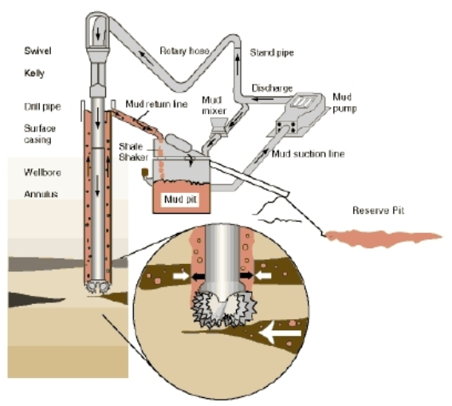

Slide 12
depth to lithological boundaries
lithology identification
Depositional Environment
inter-borehole correlation
structure mapping
dip determination.
fracture frequency
porosity, and fluid saturation (Sw &Sh).
fluid salinity
Hydrocarbon Bearing zones

Slide 13
Factors affecting log response include:
- Nature of drilling mud;
- Porosity & Permeability;
- Nature of pore fluids;
- Lithology

Slide 14
Early life of a well
Open hole logging
Cased hole logging
Perforation & Production logging

Slide 15
What does logging mean?
7000
7001
7002
7003
7004
7005
7006
7007
7008
7009
7010
7011
7012
7013
7014
7015
7016

Slide 16
What does logging mean?
Tool string is moving at a certain logging speed, and data are recorded at certain intervals called sampling rate.
7000
7001
7002
7003
7004
7005
7006
7007
7008
7009
7010
7011
7012
7013
7014
7015
7016

Slide 17
What does logging mean?
7000
7001
7002
7003
7004
7005
7006
7007
7008
7009
7010
7011
7012
7013
7014
7015
7016

Slide 18
What does logging mean?
7000
7001
7002
7003
7004
7005
7006
7007
7008
7009
7010
7011
7012
7013
7014
7015
7016

Slide 19
What does logging mean?
7000
7001
7002
7003
7004
7005
7006
7007
7008
7009
7010
7011
7012
7013
7014
7015
7016

Slide 20
What does logging mean?
7000
7001
7002
7003
7004
7005
7006
7007
7008
7009
7010
7011
7012
7013
7014
7015
7016

Slide 21
What does logging mean?
7000
7001
7002
7003
7004
7005
And we get a group of wiggly lines called a “log”
7006
7007
7008
7009
7010
7011
7012
7013
7014
7015
7016

Slide 22
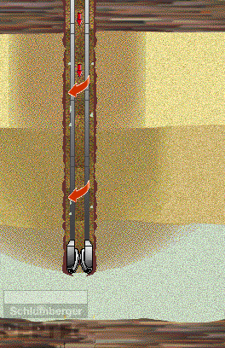
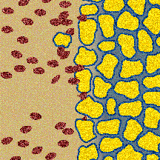
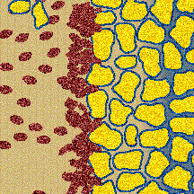
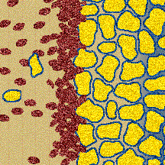
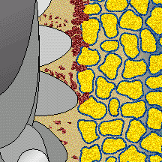
Invasion

Slide 23
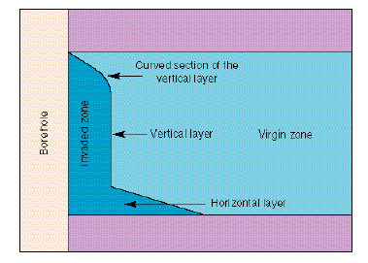
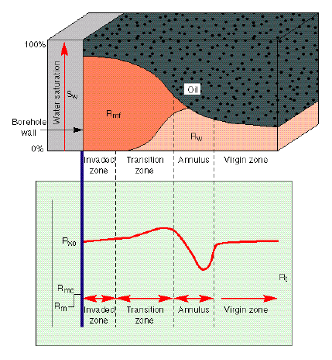
Invasion

Slide 24
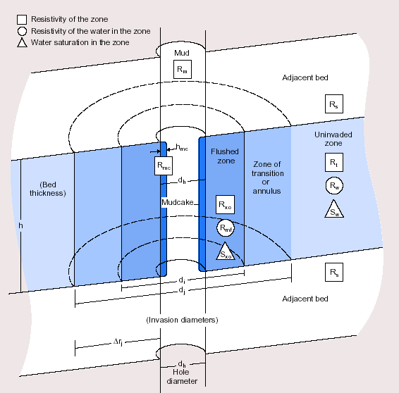
Invasion

Slide 25
Depth of invasion and Resolution of log tools.

Slide 26
Drilling mud
Drilling mud is a liquids pumped through drilling pipe, it is composed
of (fresh water, saline water, oil or chemicals…)
Some solid materials (Bentonite clay, Barite, Limes, Tuffs, Nut crust, …) added to the drill mud to control its properties (density, viscosity, water losses, gains or kick, resistivity, PH …).
LCM Lose Circulation Mud to prevent losses

Slide 27
Functions of the drilling mud:
1- Pulling the samples into the surface
2- Cooling and lubricating the Bit and pipes
3- Plastering the hole's wall by formation of
mud cake, prevent caves-in & damaging
4- Control the hole condition pressure.
5- Support a part of pipes load & casing tube
6- Remain the cutting suspended during the
rest of drilling operation…
7- Used as an indicator for the oil, gas, rock.

Slide 28
Drilling Mud types:
- Salt base mud or Salt mud, characterized by low resistivity mud (Rmf ≈ Rw).
- Fresh mud, or oil base mud, high resistivity ( Rmf > Rw).
In more drilling operation the water (fresh or salty) base mud are used, but in some cases it is necessary to use oil base mud or mixed oil - gas or foam base mud:
1- To drill the shale layers (if has the swelling problem)
2- In the deep drilling wells with high temperature
3- To core drilling (reservoir zone)
4- The intervals of Salt, Anhydrite, potash,…etc.
5- Directional drilling (inclined) or slim hole (narrow)
6- Other special cases

Slide 29
The differential pressure forces mud filtrate into the permeable formation and the solid particles of the mud are deposited on the borehole wall were they form mud cake .
(Low permeable bed reduce the rate of infiltration).

Slide 30
Borehole Environment:
Invasion process … During the drilling operation the mud in the borehole is usually conditioned so that the hydrostatic pressure of the mud column is greater than the pressure of the formations.
The differential pressure forces mud filtrate into the permeable formation, makes the mud cake, flushed zone, transition zone …

Slide 31
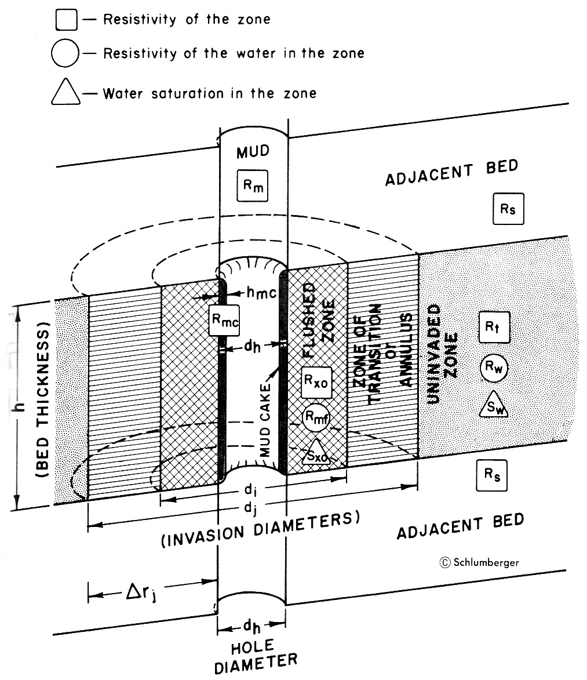
Borehole Environment:
1-Invasione zone . a- Flushed zone. b- Transition zone.
+ annulus zone
2- Uninvaded zone

Slide 32
Invasion Model
Mud
Adjacent bed
Rm
Uninvaded
zone
Flushed zone
Rt
Transition
Zone
Rmc
Rw
Rxo
Mudcake
Sw
Rmf
Sxo
h
Adjacent bed
Bed thickness
Invasion diameters

Slide 33
Depth of Investigation
How far the logging sensor can detect
  Deep resistivity/induction logging tool – Virgin zone
  Neutron and Density logging tool – Transition zone
    We only consider them on Flushed zone for this training
  All other tools – Flushed zone

Slide 34
Flushed zone:
Very close to the hole, all formation fluids (water & oil) flushed away by filtrate.
Transition zone:
Farther out from the borehole the displacement of formation fluids is less and less complete, resulting in transition zone with progressive change in resistivity from Rxo….Ri … to Rt of the
Uninvaded zone.

Slide 35
In general, invasion is small in very porous and permeable formations, the mud cake building up rapidly to block dynamic filtration.
Where mud cake is slow and invasion may be very deep, up to several meters in poorly permeable zones (vuggy carbonate or fractured formations).
The depth of invasion related to the hole diameter and porosity of formation

Slide 36
Terms and Symbols Used in Wireline Logging
a tortuosity factor
BHT bottom hole temperature
BVW bulk volume water
c conductivity
Cp compaction factor for sonic porosity
rj radius of invaded zone
Dt interval transit time of formation
Dtf interval transit time of fluid in borehole
Dtma interval transit time of formation matrix
dh diameter of borehole
di diameter of invaded zone (flushed zone)
dj diameter of invaded zone
F formation factor

Slide 37
GR log gamma ray reading from formation
GR max gamma ray reading from shale
hmc thickness of mudcake
ka absolute permeability
ke effective permeability
krg relative permeability to gas
kro relative permeability to oil
krw relative permeability to water
m cementation exponent
MOS movable oil saturation (Sxo - Sw)
Ø phi porosity
PSP pseudostatic spontaneous potential
ρb bulk density of the formation
ρf density of fluid in borehole
ρh hydrocarbon density

Slide 38
ρma density of formation matrix
Rfl resistivity of shallow focused log
Ri resistivity of invaded zone
Rilm resistivity of induction long medium
Rild resistivity induction log deep
Rlld resistivity laterolog deep
Rlls resistivity laterolog shallow
Rm resistivity of drilling mud
Rmc resistivity of mud cake
Ro resistivity of the formation 100% water saturated
ROS residual oil saturation (1.0 - Sxo)
Rs resistivity of adjacent shale
Rsfl resistivity of spherically focused log
Rt resistivity of uninvaded zone

Slide 39
Rw resistivity of formation water
Rwa apparent formation water resistivity
Rxo resistivity of flushed zone
Sh hydrocarbon saturation (1.0 - Sw)
SP spontaneous potential
SPI secondary porosity index
SSP static spontaneous potential
Swirr irreducible water saturation
Swa water saturation of un-invaded zone (Archie Method)
Swr water saturation of invaded zone (Ratio Method)
Sw/Sxo movable hydrocarbon index
Sxo water saturation of flushed zone
Tf formation temperature
Vsh volume of shale

Slide 40
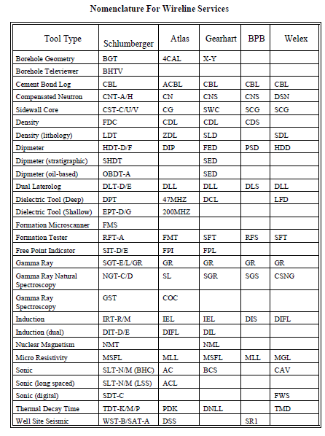

Slide 41
Log Selection
A “normal” logging suite involves:
Run #1: Induction - Acoustic - Gamma Ray – SP
Run #2: Density - Neutron - Spectral Gamma Ray
Run #3: Dual Laterolog - Micro-Resistivity Log – SP
Additional logging suite involves:
Run #4: Dipmeter
Run #5: Formation Tester
Run #6: Well Seismic Tool
Run #7: Side Wall Core Guns

